Slide 1
Object Oriented Programming Through java

Slide 2
Syllabus
Oopj Theory Syllabus
Oopj Lab Syllabus

Slide 3
Principles of OOPs
Objects
Classes
Data abstraction and Encapsulation
Inheritance
Polymorphism
Dynamic Binding
Message passing

Slide 4
What is Java?
Where it is used?
Types of Java Applications

Slide 5
What is Java?
  Java is a programming language and a platform.
  Java is a high level, robust, secured and object-oriented programming language.
  Platform: Any hardware or software environment in which a program runs, is known as a platform. Since Java has its own runtime environment (JRE) and API, it is called platform.

Slide 6
Where it is used?
According to Sun, 3 billion devices run java. There are many devices where java is currently used. Some of them are as follows:
Desktop Applications such as acrobat reader, media player, antivirus etc.
Web Applications such as irctc.co.in, javatpoint.com etc.
Enterprise Applications such as banking applications.
Mobile
Embedded System
Smart Card
Robotics
Games etc

Slide 7
Types of Java application
There are mainly 4 type of applications that can be created using java:
1) Standalone Application
It is also known as desktop application or window-based application. An application that we need to install on every machine such as media player, antivirus etc. AWT and Swing are used in java for creating standalone applications.
2) Web Application
An application that runs on the server side and creates dynamic page, is called web application. Currently, servlet, jsp, struts, jsf etc. technologies are used for creating web applications in java.
3) Enterprise Application
An application that is distributed in nature, such as banking applications etc. It has the advantage of high level security, load balancing and clustering. In java, EJB is used for creating enterprise applications.
4) Mobile Application
An application that is created for mobile devices. Currently Android and Java ME are used for creating mobile applications.

Slide 8
UNIT-I

Slide 9
UNIT-I
JAVA BASICS
History of Java
Java buzzwords
Data types
Variables, scope and life time of variables
Arrays
Operators, expressions, control statements
Type conversion and casting
Simple java program
Classes and objects – concepts of classes, objects
Constructors, methods
Access control
This keyword
Garbage collection
Overloading methods and constructors
Parameter passing
Recursion
String handling , StringTokenizer

Slide 10
Java Basics:-
History of java:-
Java was developed by
  James Gosling,
  Patrik Naughton,
  Chris Warth,
  Ed Frank, and
  Mike Sheridan
  at Sun Microsystems, Inc in 1991.

Slide 11
History of Java
Java started out as a research project.
Research began in 1991 as the Green Project at Sun Microsystems, Inc.
Research efforts birthed a new language, OAK. ( A tree outside of the window of James Gosling’s office at Sun).
Java is available as jdk and it is an open source s/w.

Slide 12
Contd..
It was started in 1991 as a project named “Green”, to develop a platform-independent language that can be used to create software to be embedded in various consumer electronic devices, such as microwave ovens and remote controls etc.
  Many different types of CPU’s are used as controllers.
  C & C++ ( and most other languages ) are designed to be compiled for a specific target.
  It is possible to compile a C++ program for any type of CPU, but requires a full C++ compiler for that CPU.
  Compilers are expensive and time-consuming to create.
.

Slide 13
History of Java (contd…)
Language was created with 5 main goals:
It should be object oriented.
A single representation of a program could be executed on
multiple operating systems. (i.e. write once, run anywhere)
It should fully support network programming.
It should execute code from remote sources securely.
It should be easy to use.
Oak was renamed Java in 1995.

Slide 14

James Gosling

Slide 15

Green Team

Slide 16

Java Logo

Slide 17
Versions of Java
Version | Codename | Year | Features Added
JDK 1.0 | Oak | Jan23,1996 | -
JDK 1.1 | Rebirth of Java | Feb19,1997 | Inner classes JavaBeans, JDBC, RMI, Reflection, AWT.
J2SE 1.2 | Playground | Dec8, 1998 | JIT compiler, Collections, IDL & CORBA, strictfp, Java Plug-in.
J2SE 1.3 | Kestrel | May8, 2000 | HotSpot JVM, JavaSound, Java Naming and Directory Interface, Java Platform Debugger Architecture.
J2SE 1.4 | Merlin | Feb6, 2002 | Preferences API, Logging API, assert, image I/O API, security and cryptography extensions.
J2SE 5.0 | Tiger | Sep30, 2004 | Generics, annotations, Autoboxing, Enumerations, Varargs, Enhanced for each.
JAVA SE 6 | Mustang | Dec11, 2006 | JDBC 4.0, JVM improvements, Improved JAXB, Improved web services, Support for older Win9x versions dropped.
JAVA SE 7 | Dolphin | July28, 2011 | Major updates to Java
JAVA SE 8 | Spider | 2014,March | -

Slide 18
Java Platforms
There are three main platforms for Java:
Java SE (Java Platform, Standard Edition) – runs on desktops and laptops.
Java ME (Java Platform, Micro Edition) – runs on mobile devices such as cell phones.
Java EE (Java Platform, Enterprise Edition) – runs on servers.

Slide 19
Java Terminology
Java Development Kit:
It contains one (or more) JRE's along with the various development tools like the Java source compilers, bundling and deployment tools, debuggers, development libraries, etc.
Java Virtual Machine:
An abstract machine architecture specified by the Java Virtual Machine Specification.
It interprets the byte code into the machine code depending upon the underlying OS and hardware combination. JVM is platform dependent. (It uses the class libraries, and other supporting files provided in JRE)

Slide 20
Java Terminology (contd…)
Java Runtime Environment:
A runtime environment which implements Java Virtual Machine, and provides all class libraries and other facilities necessary to execute Java programs. This is the software on your computer that actually runs Java programs.
JRE = JVM + Java Packages Classes (like util, math, lang, awt, swing etc) +runtime libraries.

Slide 21
Java Execution Procedure
Class Loader Byte Code Verifier
Java Class
Libraries
Java Source
Java Byte codes move locally or through n/w
Java
Interpreter
Just-in-time
Compiler
Java
Compiler
Run Time System
Java
Byte codes
Java OS
W
Win 32
Solaris
MAC
Others
Hardware

Slide 22
JVM
Source File (HelloWorld.java)
Class Loader
Byte Code Verifier
Compiler (javac)
Interpreter
JIT Code
Generator
Runtime
Machine Code or Byte code
(HelloWorld.class)
Operating System
Hardware
Notes:
The JVM Runtime Environment
The byte codes are stored in class files. At runtime, the bytecodes that make up a java software program are loaded, checked, and run in an interpreter. The interpreter has two functions: it executes bytecodes, and makes the appropriate calls to the underlying hardware.
The Java runtime environment runs code compiled for a JVM and performs four main tasks:
Loads Code - Performed by the class loader
Verifies Code - Performed by the bytecode verifier
Executes Code - Performed by the runtime interpreter
Garbage Collection - De allocates memory not being used
Class Loader
The class loader loads all classes needed for the execution of a program. The class loader adds security by separating the namespaces for the classes of the local file system from those imported from network sources.
Once all the classes have been loaded, the memory layout of the executable file is determined. At this point specific memory addresses are assigned to symbolic references and the lookup table is created. Because memory layout occurs at runtime, the java technology interpreter adds protection against unauthorized access into the restricted areas of code.
Java software code passes several tests before actually running on your machine. The JVM puts the code through a bytecode verifier that tests the format of code fragments and checks code fragments for illegal code – code that forges pointers, violates access rights on objects, or attempts to change object type.

Slide 23
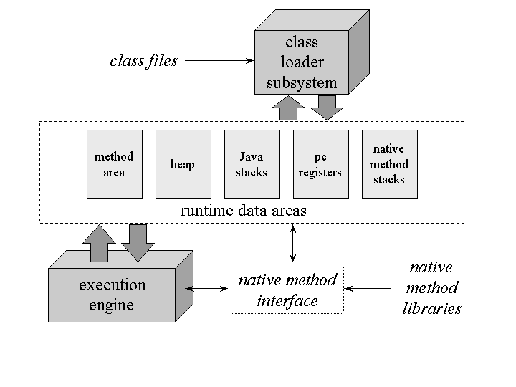
The Architecture of the Java Virtual Machine

Slide 24
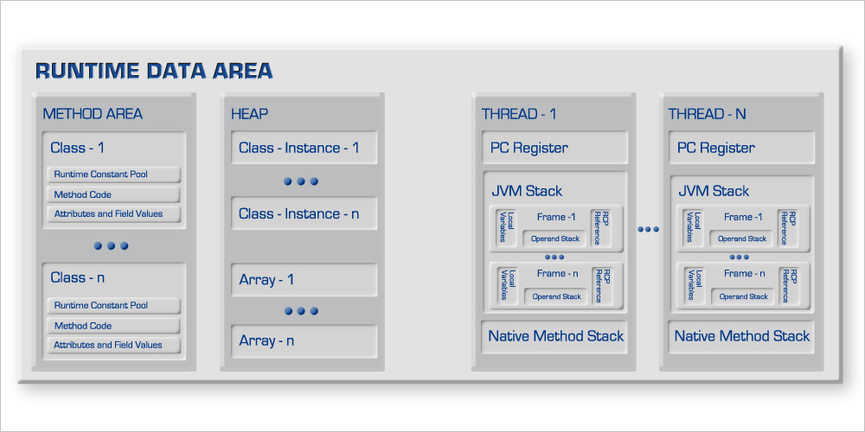

Slide 25
Java Virtual Machine
Class loader subsystem: A mechanism for loading types (classes and interfaces) given fully qualified names.
The Java virtual machine organizes the memory it needs to execute a program into several runtime data areas.
Each Java virtual machine also has an execution engine: a mechanism responsible for executing the instructions contained in the methods of loaded classes.

Slide 26
Class loader subsystem
The Java virtual machine contains two kinds of class loaders: a bootstrap class loader and user-defined class loaders.
The bootstrap class loader is a part of the virtual machine implementation, and user-defined class loaders are part of the running Java application.
Loading: finding and importing the binary data for a type
Linking: performing verification, preparation, and (optionally) resolution
  Verification: ensuring the correctness of the imported type
  Preparation: allocating memory for class variables and initializing the memory to default values
  Resolution: transforming symbolic references from the type into direct references.
Initialization: invoking Java code that initializes class variables to their proper starting values.

Slide 27
When the virtual machine loads a class file, it parses information about a type from the binary data contained in the class file.
It places this type information into the method area.
As the program runs, the virtual machine places all objects the program instantiates onto the heap.
As each new thread comes into existence, it gets its own pc register (program counter) and Java stack.

Slide 28
Binary form of a .class file(partial)
public class Hello
{
public static void main(String[] args)
{
System.out.println("Hello, World!");
}
}
0000: cafe babe 0000 002e 001a 0a00 0600 0c09 ................
0010: 000d 000e 0800 0f0a 0010 0011 0700 1207 ................
0020: 0013 0100 063c 696e 6974 3e01 0003 2829 .....<init>...()
0030: 5601 0004 436f 6465 0100 046d 6169 6e01 V...Code...main.
0040: 0016 285b 4c6a 6176 612f 6c61 6e67 2f53 ..([Ljava/lang/S
0050: 7472 696e 673b 2956 0c00 0700 0807 0014 tring;)V........
0060: 0c00 1500 1601 000d 4865 6c6c 6f2c 2057 ........Hello, W
0070: 6f72 6c64 2107 0017 0c00 1800 1901 0005 orld!...........
0080: 4865 6c6c 6f01 0010 6a61 7661 2f6c 616e Hello...java/lan
0090: 672f 4f62 6a65 6374 0100 106a 6176 612f g/Object...java/
00a0: 6c61 6e67 2f53 7973 7465 6d01 0003 6f75 lang/System...ou ...

Slide 29
What is the Difference b/w OO and OB Languages?
In Object based languages inheritance is not supported so that dynamic polymorphism also not supported.
E.g. VB,VC++.
Is C++ partial OOP?
Yes, C++ is a partial OOP because without using class also we can able to write the program.
Is Java total OOP or partial OOP?
Java is a total oop language because with out object orientation we can’t able to write any program.

Slide 30
Java is a pure oop or not ?
By default java is not pure object oriented language.
Java is called as Hybrid language.
Pure oop languages are “small talk”, ”ruby”, “Eiffel”.

Slide 31
Differences b/w C++ and Java
C++ Java
1. Global variable are 1. No Global variables.
supported. Everything must be inside
the class only.
2.Multiple inheritance 2. No direct multiple
is supported. Inheritance.

Slide 32
C++ Java
3.Constructors and 3.Java supporting constructors
Destructors supported. only & instead of destructors
garbage collection is
supported.
4.In c++ pointers are 4.No pointer arithmetic in Java.
supported.
5.C++ supporting ASCII 5. Java supports Uni code
character set. Character set.

Slide 33
Buzzwords of Java
Simple
Object-Oriented
Platform independent
Secured
Robust
Architecture neutral
Portable
Interpreted and High Performance
Multithreaded
Dynamic
Distributed

Slide 34
Java Features (1)
Simple
  fixes some clumsy features of C++ (ex: explicit pointers, operator overloading etc. )
  automatic garbage collection
  rich pre-defined class library
Object oriented
  focus on the data (objects) and methods manipulating the data
  all functions are associated with objects
  almost all datatypes are objects (files, strings, etc.)
  potentially better code organization and reuse

Slide 35
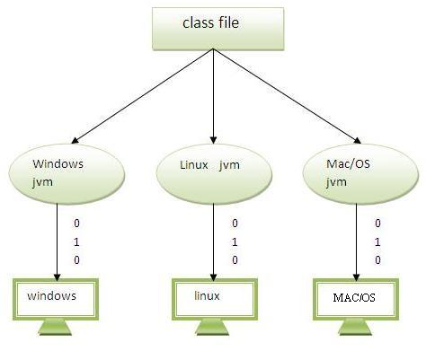
Platform Independent
Java code can be run on multiple platforms e.g.Windows,Linux,Sun Solaris,Mac/OS etc.
Java code is compiled by the compiler and converted into bytecode.
This bytecode is a platform independent code because it can be run on multiple platforms i.e. Write Once and Run Anywhere(WORA).

Slide 36
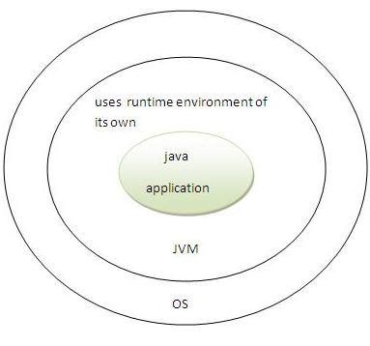
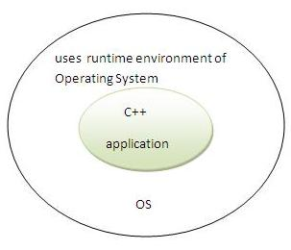
Java Features (3)
Secure
  it is secured because:
    No explicit pointer
    Programs run inside virtual machine sandbox.
  usage in networked environments requires more security

Slide 37
Robust
  extensive compile-time and runtime error checking
  Java uses strong memory management .
  automatic garbage collection tracks objects usage over time.
Architecture-Neutral
  the sizes of the primitive data types are always the same
  the libraries define portable interfaces .
  Goal of java designers is “write once; run anywhere, any time, forever.”

Slide 38
Java Features (2)
Portable
  same application runs on all platforms
Interpreted and High Performance
  java compiler generate byte-codes, not native machine code
  the compiled byte-codes are platform-independent
  java bytecodes are translated on the fly to machine readable instructions in runtime (Java Virtual Machine)
easy to translate directly into native machine code by using a just-in-time compiler.

Slide 39
Java Features (4)
Multithreaded
  multiple concurrent threads of executions can run simultaneously
  The main advantage of multi-threading is that it shares the same memory.
  Threads are important for multi-media, Web applications etc.

Slide 40
Java Features (5)
Dynamic
  java is designed to adapt to evolving environment
  libraries can freely add new methods and instance variables without any effect on their clients
  interfaces promote flexibility and reusability in code by specifying a set of methods an object can perform, but leaves open how these methods should be implemented
  can check the class type in runtime

Slide 41
Java Features (6)
Distributed
  Java is designed for the distributed environment of the Internet, because it handles TCP/IP protocols.
  Allows objects on two different computers to execute procedures remotely by using package called Remote Method Invocation (RMI).

Slide 42
Byte Code
Bytecode is a highly optimized set of instructions designed to be executed by the Java run-time system, which is called the Java Virtual Machine (JVM).
The JVM is an interpreter for bytecode.

Slide 43
Keywords
abstract continue goto package synchronized
assert default if private this
boolean do implements protected throw
break double import public throws
byte else instanceof return transient
case extends int short try
catch final interface static void
char finally long strictfp volatile
class float native super while
const for new switch

Slide 44
Data Types
Simple Type
Derived Type
User-defined Type

Slide 45
Data Types
Simple Type
Derived Type
User Defined Type
E.g: Array, String…
Numeric Type
Non-Numeric
class
Interface
Integer
Float
Char
Boolean
float
double
byte
short
int
long

Slide 46
integer types
Java does not support unsigned, positive-only integers.
All are signed, positive and negative values.
Name Width Range
long 64 –9,223,372,036,854,775,808 to 9,223,372,036,854,775,807
int 32 –2,147,483,648 to 2,147,483,647
short 16 –32,768 to 32,767
byte 8 –128 to 127

Slide 47
byte
  The smallest integer type is byte.
  Variables of type byte are especially useful while working with a stream of data from a network or file.
  Byte variables are declared by use of the byte keyword.
Ex:-
  byte b, c;

Slide 48
import java.io.*;
public class IntDemo{
public static void main(String args[]){
System.out.println(" For an Integer ");
System.out.println("Size is : "+Integer.SIZE);
int i1 = Integer.MAX_VALUE;
int i2 = Integer.MIN_VALUE ;
System.out.println("Max value is : "+i1);
System.out.println("Min Value is : "+i2);
System.out.println(" For an Byte");
System.out.println("Size is : "+Byte.SIZE);
byte b1 = Byte.MAX_VALUE;
byte b2 = Byte.MIN_VALUE ;
System.out.println("Max value is : "+b1);
System.out.println("Min Value is : "+b2);
System.out.println(" For an Short");
System.out.println("Size is : "+Short.SIZE);
short s1 = Short.MAX_VALUE;
short s2 = Short.MIN_VALUE ;
System.out.println("Max value is : "+s1);
System.out.println("Min Value is : "+s2);
System.out.println(" For an Long");
System.out.println("Size is : "+Long.SIZE);
long l1 = Long.MAX_VALUE;
long l2 = Long.MIN_VALUE ;
System.out.println("Max value is : "+l1);
System.out.println("Min Value is : "+l2);
}
}

Slide 49
Floating-Point Types
There are two kinds of floating-point types.
All math functions, such as sin( ), cos( ), and sqrt( ), return double values.
Name Width in Bits Approximate Range
double 64 4.9e–324 to 1.8e+308
float 32 1.4e−045 to 3.4e+038

Slide 50
import java.io.*;
public class FloatDemo{
public static void main(String args[]){
System.out.println(" For an Float");
System.out.println("Size is : "+Float.SIZE);
float f1 = Float.MAX_VALUE;
float f2 = Float.MIN_VALUE ;
System.out.println("Max value is : "+f1);
System.out.println("Min Value is : "+f2);
System.out.println(" For an Double");
System.out.println("Size is : "+Double.SIZE);
double d1 = Double.MAX_VALUE;
double d2 = Double.MIN_VALUE ;
System.out.println("Max value is : "+d1);
System.out.println("Min Value is : "+d2);
}
}

Slide 51
Characters
  char in Java is not the same as char in C or C++.
  In C/C++, char is an integer type that is 8 bits wide.
  Java uses Unicode to represent characters.
  Unicode defines a fully international character set that can represent all of the characters found in all human languages.
  It is a unification of dozens of character sets, such as Latin, Greek, Arabic, Cyrillic, Hebrew, Katakana, Hangul, and many more.
  Hence it requires 16 bits.
  The range of a char in java is 0 to 65,536.
  There are no negative chars.

Slide 52
import java.io.*;
public class CharDemo{
public static void main(String args[]){
System.out.println(Character.SIZE);
int c1 = Character.MAX_VALUE;
int c2 = Character.MIN_VALUE;
System.out.println(" c1 = " + c1);
System.out.println(" c2 = " + c2);
}
}

Slide 53
Booleans
It can have only one of two possible values, true or false.
This is the type returned by all relational operators, such
as a < b.

Slide 54
Variables
The variable is the basic unit of storage in a Java program.
A variable is defined by the combination of an identifier, a type, and an optional initializer.
Declaring a Variable
In Java, all variables must be declared before they can be used.
  type identifier [ = value][, identifier [= value] ...] ;

Slide 55
The Scope and Lifetime of Variables
Scope
The scope of a declared element is the portion of the program where the element is visible.
Lifetime
The lifetime of a declared element is the period of time during which it is alive.
Java allows variables to be declared within any block.
A block begins with an opening curly brace and ends by a closing curly brace.
A block defines a scope. Thus, each time you start a new block, you are creating a new scope.

Slide 56
Contd..
In Java, there are major scopes which are defined by a class and a method.
Scopes defined by a method
The scope defined by a method begins with its opening curly brace and ends with closing curly brace.
Scopes can be nested.
Objects declared in the outer scope will be visible to code within the
inner scope. The reverse is not true.
Objects declared within the inner scope will not be visible outside it.

Slide 57
public class Scope
{
public static void main(String args[])
{
int x; //know to all code within main
x=10;
if(x==10)
{ // starts new scope
int y=20; //Known only to this block
//x and y both known here
System.out.println("x and y: "+x+" "+y);
x=y+2;
}
// y=100; // error ! y not known here
//x is still known here
System.out.println("x is "+x);
}
}

Slide 58
Operators
Arithmetic Operators
Operator Result
+ Addition
– Subtraction (also unary minus)
* Multiplication
/ Division
% Modulus
++ Increment
+= Addition assignment
–= Subtraction assignment
*= Multiplication assignment
/= Division assignment
%= Modulus assignment
– – Decrement

Slide 59
The operands of the arithmetic operators must be of a numeric type.
You cannot use them on boolean types, but you can use them on char types.
No fractional component attached to the result, when the division operator is applied to an integer type.
The modulus operator, %, returns the remainder of a division operation. It can be applied to floating-point types as well as integer types.
  Ex:- int x = 42;
  double y = 42.25;
  x mod 10 = 2
  y mod 10 = 2.25

Slide 60
// Demonstrate the basic arithmetic operators.
class BasicMath {
public static void main(String args[]) {
// arithmetic using integers
System.out.println("Integer Arithmetic");
int a = 1 + 1;
int b = a * 3;
int c = b / 4;
int d = c - a;
int e = -d;
System.out.println("a = " + a);
System.out.println("b = " + b);
System.out.println("c = " + c);
System.out.println("d = " + d);
System.out.println("e = " + e);
// arithmetic using doubles
System.out.println("\nFloating Point Arithmetic");
double da = 1 + 1;
double db = da * 3;
double dc = db / 4;
double dd = dc - a;
double de = -dd;
System.out.println("da = " + da);
System.out.println("db = " + db);
System.out.println("dc = " + dc);
System.out.println("dd = " + dd);
System.out.println("de = " + de);
}
}

Slide 61
// Demonstrate ++ and --.
class IncDec {
public static void main(String args[]) {
int a = 1;
int b = 2;
int c;
int d;
c = ++b;
d = a++;
c++;
System.out.println("a = " + a);
System.out.println("b = " + b);
System.out.println("c = " + c);
System.out.println("d = " + d);
}
}

Slide 62
Relational Operators
The relational operators determine the relationship that one operand has to the other.
They determine equality and ordering.
Operator Result
== Equal to
!= Not equal to
> Greater than
< Less than
>= Greater than or equal to
<= Less than or equal to

Slide 63
Note :-
int done;
// ...
if(!done) ... // Valid in C/C++
if(done) ... // but not in Java.
In Java, these statements must be written like this:
if(done == 0)) ... // This is Java-style.
if(done != 0) ...
In C/C++, true is any nonzero value and false is zero.
In Java, true and false are nonnumeric values which do not relate to zero or nonzero.

Slide 64
Boolean Logical Operators
The Boolean logical operators operate only on boolean operands.
All of the binary logical operators combine two boolean values to form a resultant boolean value.
Operator Result
& Logical AND
| Logical OR
^ Logical XOR (exclusive OR)
|| Short-circuit OR
&& Short-circuit AND
! Logical unary NOT
&= AND assignment
|= OR assignment
^= XOR assignment
== Equal to
!= Not equal to
?: Ternary if-then-else

Slide 65
The Assignment Operator
The assignment operator is the single equal sign, =.
var = expression;
Here, the type of var must be compatible with the type of expression.
It allows you to create a chain of assignments.
int x, y, z;
x = y = z = 100; // set x, y, and z to 100

Slide 66
The Bitwise Operators
Java defines several bitwise operators which can be applied to the integer types, long,int, short, char, and byte.
These operators act upon the individual bits of their operands.
Operator Result
~ Bitwise unary NOT
& Bitwise AND
| Bitwise OR
^ Bitwise exclusive OR
>> Shift right
>>> Shift right zero fill
<< Shift left
&= Bitwise AND assignment
|= Bitwise OR assignment

Slide 67
Cotnd..
^= Bitwise exclusive OR assignment
>>= Shift right assignment
>>>= Shift right zero fill assignment
<<= Shift left assignment

Slide 68
The ? Operator
General form:
expression1 ? expression2 : expression3 ;
Here, expression1 can be any expression that evaluates to a boolean value. If expression1 is true, then expression2 is evaluated; otherwise, expression3 is evaluated.

Slide 69
// Demonstrate ?.
class Ternary {
public static void main(String args[]) {
int i, k;
i = 10;
k = i < 0 ? -i : i; // get absolute value of i
System.out.print("Absolute value of ");
System.out.println(i + " is " + k);
i = -10;
k = i < 0 ? -i : i; // get absolute value of i
System.out.print("Absolute value of ");
System.out.println(i + " is " + k);
}
}

Slide 70
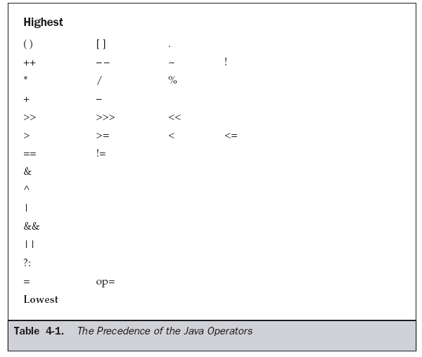
Operator Precedence

Slide 71
Control Statements
Java’s control statements can be put into the following categories:
    selection
    iteration
    jump

Slide 72
Java’s Selection Statements
Java supports two selection statements:
if ( condition )
  Same as in c/c++.
  The condition is any expression that returns a boolean value.
Switch( expression )
  Same as in c/c++.
  The expression must be of type byte, short, int, or char;
  Each of the values specified in the case statements must be of a type compatible with the expression.

Slide 73
// Demonstrate if-else-if statements.
class IfElse {
public static void main(String args[]) {
int month = 4; // April
String season;
if(month == 12 || month == 1 || month == 2)
season = "Winter";
else if(month == 3 || month == 4 || month == 5)
season = "Spring";
else if(month == 6 || month == 7 || month == 8)
season = "Summer";
else if(month == 9 || month == 10 || month == 11)
season = "Autumn";
else
season = "Bogus Month";
System.out.println("April is in the " + season + ".");
}
}

Slide 74
class Switch {
public static void main(String args[]) {
int month = 4;
String season;
switch (month) {
case 12:
case 1:
case 2:
season = "Winter";
break;
case 3:
case 4:
case 5:
season = "Spring";
break;
case 6:
case 7:
case 8:
season = "Summer";
break;
case 9:
case 10:
case 11:
season = "Autumn";
break;
default:
season = "Bogus Month";
}
System.out.println("April is in the " + season + ".");
}
}

Slide 75
Iteration Statements
Java’s iteration statements are
  for
  while
  do-while.
  Syntax is similar to c/c++.
  The condition is any expression that returns a boolean value.

Slide 76
Jump Statements
Java supports three jump statements:
  1. break
    Using break to Exit a Loop
        break;
    Using break as a Form of Goto
    label :
    - - - -
    - - - -
    break label;

Slide 77
  2. continue
      Similar to c/c++
  3. return
      The return statement is used to explicitly return from a method.
      It transfers control back to the caller of the method.

Slide 78
Type Conversion and Casting
type conversion, typecasting, refers to different ways of, implicitly or explicitly, changing an entity of one data type into another
Types of Conversions:
1.Widening conversion
2.Narrowing conversion

Slide 79
When one type of data is assigned to another type of variable, an
automatic type conversion will take place if the following two
conditions are met:
    The two types are compatible.
    The destination type is larger than the source type.
    When these two conditions are met, a widening conversion takes place.
  For widening conversions, the numeric types, including integer, floating-point, and double types, are compatible with each other.
    Ex:
    int a=10;
    double b=a;
  However, there are no automatic conversion from the numeric types to char or boolean
  Also, char and boolean are not compatible with each other.

Slide 80
The widening conversion is permitted in the following cases:
byte to short, int, long, float, or double
Short to int, long, float, or double
char to int, long, float, or double
int to long, float, or double
long to float or double
float to double

Slide 81
import java.io.*;
public class Widening{
public static void main(String args[]){
short s;
int i1,i2;
byte b1=10,b2=20;
System.out.println(“byte to short conversion");
s=b1;
System.out.println(s);
System.out.println(“byte to int conversion");
i1=b2;
System.out.println(i1);
//char to int
char c='a';
System.out.println(“char to int conversion");
i2=c;
System.out.println(i2);
}
}

Slide 82
The narrowing conversion occurs from a type to a different type that has a smaller size, such as from a long (64 bits) to an int (32 bits).
In general, the narrowing primitive conversion can occur in these cases:
short to byte or char
char to byte or short
int to byte, short, or char
long to byte, short, or char
float to byte, short, char, int, or long
double to byte, short, char, int, long, or float
The narrowing primitive conversion must be explicit.
You need to specify the target type in parentheses.

Slide 83
  it is still possible to obtain a conversion between incompatible types.
  Cast keyword / operator will be used to perform conversion between incompatible types.
    General form:
    ( target-type ) value;

Slide 84
public class Narrowing
{
public static void main(String args[])
{
byte b;
int i=257;
double d=323.142;
System.out.println("int to byte conversion");
b= (byte)i;
System.out.println("i and b values: "+i+" "+b);
System.out.println("double to int conversion");
i=(int)d;
System.out.println("d and i values: "+d+" "+i);
System.out.println("double to byte conversion");
b=(byte)d;
System.out.println("d and b values: "+d+" "+b);
}
}

Slide 85
Arrays in Java
An array is a data structure that defines an ordered collection of a fixed number of homogeneous data elements
The size of an array is fixed and cannot increase to accommodate more elements

Slide 86
Reference variables in Java (1/4)
Reference variables are used in Java to store the references of the objects created by the operator new
Any one of the following syntax can be used to create a reference to an int array
int x[];
int [] x;
The reference x can be used for referring to any int array
//Declare a reference to an int array
int [] x;
//Create a new int array and make x refer to it
x = new int[5];

Slide 87
import java.io.*;
public class Array {
public static void main(String args[]) {
int month_days[];
month_days = new int[12];
month_days[0] = 31;
month_days[1] = 28;
month_days[2] = 31;
month_days[3] = 30;
month_days[4] = 31;
month_days[5] = 30;
month_days[6] = 31;
month_days[7] = 31;
month_days[8] = 30;
month_days[9] = 31;
month_days[10] = 30;
month_days[11] = 31;
System.out.println("April has " + month_days[3] + " days.");
}
}

Slide 88
Reference Types in Java (4/4)
A reference type cannot be cast to primitive type
A reference type can be assigned ‘null’ to show that it is not referring to any object
  ‘null’ is a keyword in Java
int [] x = null;

Slide 89
Initializing an array in Java
An array can be initialized while it is created as follows
int [] x = {1, 2, 3, 4};
char [] c = {‘a’, ‘b’, ‘c’};

Slide 90
The length of an array
Unlike C, Java checks the boundary of an array while accessing an element in it
Java will not allow the programmer to exceed its boundary
If x is a reference to an array, x.length will give you the length of the array
So setting up a for loop as follows is very common in Java
for(int i = 0; i < x.length; ++i){
x[i] = 5;
}

Slide 91
import java.io.*;
public class SortNum{
public static void main(String args[])
{
int number[]={50,67,80,95,34};
int n=number.length;
System.out.println("length of array is"+n);
System.out.print("given list");
for(int i=0;i<n;i++)
{
System.out.print(" "+number[i]);
}
System.out.print("\n");
for(int i=0;i<n;i++)
{
for(int j=i+1;j<n;j++)
{
if(number[i]<number[j])
{
int temp=number[i];
number[i]=number[j];
number[j]=temp;
}
}
}
System.out.print("sorted list");
for(int i=0;i<n;i++)
{
System.out.print(" "+number[i]);
}
}
}

Slide 92
Multidimensional Arrays
Multidimensional arrays are arrays of arrays.
To declare a multidimensional array variable, specify each additional index using another set of square brackets.
int [][] x;
//x is a reference to an array of int arrays
x = new int[3][4];
//Create 3 new int arrays, each having 4 elements
//x[0] refers to the first int array, x[1] to the second and so on
//x[0][0] is the first element of the first array
//x.length will be 3
//x[0].length, x[1].length and x[2].length will be 4

Slide 93
// Demonstrate a two-dimensional array.
import java.io.*;
public class TwoDArray {
public static void main(String args[]) {
int twoD[][]= new int[4][5];
int i, j, k = 0;
for(i=0; i<4; i++)
for(j=0; j<5; j++) {
twoD[i][j] = k;
k++;
}
for(i=0; i<4; i++) {
for(j=0; j<5; j++)
System.out.print(twoD[i][j] + " ");
System.out.println();
}
}
}

Slide 94
Jagged Array
The length of each array in a multidimensional array can be different
Such an array is called a Jagged Array
int [][] x;
//x is a reference to an array of int arrays
x = new int[3][];
//Create 3 new int array references, x[0], x[1] and x[2]
//x.length is 3
x[0] = new int[4]; //x[0].length is 4
x[1] = new int[6]; //x[1].length is 6
x[2] = new int[3]; //x[2].length is 3
for(int i = 0; i < x.length; ++i)
for(int j = 0; j < x[i].length; ++j)
System.out.println(x[i][j]);

Slide 95
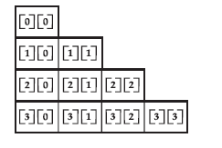
class TwoDAgain {
public static void main(String args[]) {
int twoD[][] = new int[4][];
twoD[0] = new int[1];
twoD[1] = new int[2];
twoD[2] = new int[3];
twoD[3] = new int[4];
int i, j, k = 0;
for(i=0; i<4; i++)
for(j=0; j<i+1; j++) {
twoD[i][j] = k;
k++;
}
for(i=0; i<4; i++) {
for(j=0; j<i+1; j++)
System.out.print(twoD[i][j] + " ");
System.out.println();
}
}
}

Slide 96
java program structure
In Java :
  A program is made up of one or more classes.
  One class is marked as the special “starting” class.
  Name of the file should coincide with the name of starting class.
  When a Java program is launched by the interpreter ( JVM ), it invokes a static method named “main” in the start class.

Slide 97
Sample Program
public class HelloWorld {
public static void main (String args []) {
System.out.println (“Welcome to Java Programming…..”);
}
}
public allows the program to control the visibility of class
members. When a class member is preceded by public, then that
member may be accessed by code outside the class in which it is
declared. In this case, main ( ) must be declared as public, since it
must be called by code outside of its class when the program is
started.

Slide 98
static allows main( ) to be called without having to instantiate a
particular instance of the class. This is necessary since main ( ) is
called by the Java interpreter before any objects are made.
void states that the main method will not return any value.
main() is called when a Java application begins. In order to run
a class, the class must have a main method.
string args[] declares a parameter named args, which is an array of
String. In this case, args receives any command-line arguments
present when the program is executed.

Slide 99
System is a class which is present in java.lang package.
out is a static field present in System class which returns a
PrintStream object. As out is a static field it can call directly with
classname.
println() is a method which present in PrintStream class which
can call through the PrintStream object return by static field out
present in System class to print a line to console.

Slide 100
sample1.java
public class sample{
public static void main(String args[]){
System.out.println("sample:main");
}
}
javac sample1.java
error

Slide 101
The General Form of a Class
A class is collection of objects of similar type or it is a template
class classname {
type instance-variable1;
type instance-variable2;
…
type instance-variableN;
type methodname1(parameter-list) {
body of method
}
type methodname2(parameter-list) {
body of method
}
…
type methodnameN(parameter-list) {
body of method
}
}

Slide 102
The data, or variables, defined within a class are called instance variables.
Functions defined within a class are called methods.
The methods and variables defined within a class are called members of the class.
Note:-
The class declaration and the implementation of the
methods are stored in the same place and not defined separately.

Slide 103
Constructors and Methods

Slide 104
Constructors and Methods
A constructor is a special member function whose task is to initialize the objects of its class.
A constructor has the same name as the class in which it resides and is syntactically similar to a method.
A constructor initializes an object immediately upon creation.
The constructor is automatically called immediately after the object is created.
If no constructor in program .System provides its own constructor called as default constructor.
Constructors doesn’t have any return type.
A constructor which accepts parameters is called as parameterized constructor.

Slide 105
Default Constructor:
A constructor that accepts no parameters is called Default constructor.
If not defined, provided by the compiler.
The default constructor is called whenever an object is created without specifying initial values.
Ex: class Box {
double width;
double height;
double depth;
Box() {
width = 10;
height = 10;
depth = 10;
}
}
// declare, allocate, and initialize Box objects Box mybox1 = new Box();

Slide 106
Methods
General Form:
type name(parameter-list) {
// body of method
}
The type of data returned by a method must be compatible with the return type specified by the method.
The variable receiving the value returned by a method must also be compatible with the return type specified for the method.
        return value;
Here, value is the value returned.
Ex:
double volume() {
return w*h*d;
}

Slide 107
class Box {
double width;
double height;
double depth;
// This is the constructor for Box.
Box() {
System.out.println("Constructing Box");
width=2 ;
height =3;
depth =4;
}
// compute and return volume
double volume() {
return width * height * depth;
}
}
public class BoxDemo {
public static void main(String args[]) {
// declare, allocate, and initialize Box objects
Box mybox1 = new Box();
double vol;
// get volume of box
vol = mybox1.volume();
System.out.println("Volume is " + vol);
}
}

Slide 108
Parameterized constructor
The constructor that can take the arguments are called parameterized constructors
class Box {
double width;
double height;
double depth;
Box(double w, double h, double d) {
width = w;
height = h;
depth = d;
}
}
// declare, allocate, and initialize Box objects
Box mybox1 = new Box(10, 20, 15);

Slide 109
class Box {
double width;
double height;
double depth;
// This is the constructor for Box.
Box(double w, double h, double d) {
System.out.println("Constructing Box");
width = w;
height = h;
depth = d;
}
// compute and return volume
double volume() {
return width * height * depth;
}
}
class BoxDemo2 {
public static void main(String args[]) {
// declare, allocate, and initialize Box objects
Box mybox1 = new Box(1, 2, 5);
Box mybox2 = new Box(3, 6, 9);
double vol;
// get volume of first box
vol = mybox1.volume();
System.out.println("Volume is " + vol);
// get volume of second box
vol = mybox2.volume();
System.out.println("Volume is " + vol);
}
}

Slide 110
Access Control
private:
  A private member is accessible only to the class in which it is defined.
  Use private keyword to create private members.
protected:
  Allows the class itself, subclasses, and all classes in the same package to access the members.
  To declare a protected member, use the keyword protected.

Slide 111
public:
  Any class, in any package ,has access to a class's public members.
  To declare a public member, use the keyword public.
default :
  When no access specifier is used, then by default the member of a class is public within its own package, but cannot be accessed outside of its package.

Slide 112
class Test {
int a; // default access
public int b; // public access
private int c; // private access
/*protected applies only when inheritance is involved*/
// methods to access c
void setc(int i) { // set c's value
c = i;
}
int getc() { // get c's value
return c;
}
}
class AccessTest {
public static void main(String args[]) {
Test ob = new Test();
// These are OK, a and b may be accessed directly
ob.a = 10;
ob.b = 20;
// This is not OK and will cause an error
//ob.c = 100; // Error!
// You must access c through its methods
ob.setc(100); // OK
System.out.println(ob.a + " " +ob.b + " " + ob.getc());
}
}

Slide 113
The this Keyword
this keyword is used inside any method to refer to the current object.
Usage of java this keyword
Here is given the 6 usage of java this keyword.
this keyword can be used to refer current class instance variable.
this() can be used to invoke current class constructor.
this keyword can be used to invoke current class method (implicitly)
this can be passed as an argument in the method call.
this can be passed as argument in the constructor call.
this keyword can also be used to return the current class instance.

Slide 114
Instance Variable Hiding
In java, it is illegal to declare two local variables with the same name inside the same or enclosing scopes.
But , you can have local variables, including formal parameters to methods, which overlap with the names of the class’ instance variables.
When a local variable has the same name as an instance variable, the local variable hides by the instance variable.

Slide 115
Contd..
Therefore ,this can be used to resolve any name collisions that might occur between instance variables and local variables.
ex:
double width,height,depth;
Box(double width, double height, double depth) {
this.width = width;
this.height = height;
this.depth = depth;
}

Slide 116
//instance variables and local variables are different
class Box
{
int w=5,h=5,d=5;
Box(int w1,int h1, int d1)
{
w=w1;
h=h1;
d=d1;
}
int volume()
{
return w*h*d;
}
}
class Ex5
{
public static void main(String args[])
{
Box b=new Box(1,2,3);
System.out.println("result is"+b.volume());
}
}

Slide 117
// instance variables and local variables are same
class Box
{
int w=5,h=5,d=5;
Box(int w,int h, int d)
{
w=w;
h=h;
d=d;
}
int volume()
{
return w*h*d;
}
}
class Ex5
{
public static void main(String args[])
{
Box b=new Box(1,2,3);
System.out.println("result is"+b.volume());
}
}

Slide 118
// for hiding instance variables by using ‘this’ keyword
class Box
{
int w=5,h=5,d=5;
Box(int w,int h, int d)
{
this.w=w;
this.h=h;
this.d=d;
}
int volume()
{
return w*h*d;
}
}
class Ex5
{
public static void main(String args[])
{
Box b=new Box(1,2,3);
System.out.println("result is"+b.volume());
}

Slide 119
2) this() can be used to invoked current class constructor.
The this() constructor call can be used to invoke the current class constructor (constructor chaining).
This approach is better if you have many constructors in the class and want to reuse that constructor.
class Student13{
int id;
String name;
Student13(){
System.out.println("default constructor is invoked");
}
Student13(int id,String name){
this ();//it is used to invoked current class constructor.
this.id = id;
this.name = name;
}
void display(){System.out.println(id+" "+name);}
public static void main(String args[]){
Student13 e1 = new Student13(111,"karan");
Student13 e2 = new Student13(222,"Aryan");
e1.display();
e2.display();
}
}

Slide 120
class Student14{
int id;
String name;
String city;
Student14(int id,String name){
this.id = id;
this.name = name;
}
Student14(int id,String name,String city){
this(id,name);//now no need to initialize id and name
this.city=city;
}
void display(){System.out.println(id+" "+name+" "+city);}
public static void main(String args[]){
Student14 e1 = new Student14(111,"karan");
Student14 e2 = new Student14(222,"Aryan","delhi");
e1.display();
e2.display();
}
}

Slide 121
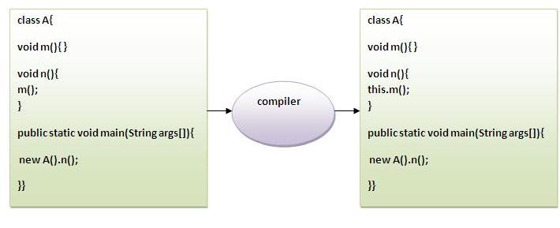
3)The this keyword can be used to invoke current class method (implicitly).
You may invoke the method of the current class by using the this keyword. If you don't use the this keyword, compiler automatically adds this keyword while invoking the method.
EX:

Slide 122
class S{
void m(){
System.out.println("method is invoked");
}
void n(){
this.m();//no need because compiler does it for you.
}
void p(){
n();//complier will add this to invoke n() method as this.n()
}
public static void main(String args[]){
S s1 = new S();
s1.p();
}
}

Slide 123
4) this keyword can be passed as an argument in the method.
The this keyword can also be passed as an argument in the method. It is mainly used in the event handling.
Ex:
class S2
{
void m(S2 obj)
{
System.out.println("method is invoked");
}
void p()
{
m(this);
}
public static void main(String args[])
{
S2 s1 = new S2();
s1.p();
}
}

Slide 124
5) The this keyword can be passed as argument in the constructor call.
We can pass the this keyword in the constructor also. It is useful if we have to use one object in multiple classes.
class B{
A4 obj;
B(A4 obj){
this.obj=obj;
}
void display(){
System.out.println(obj.data);//using data member of A4 class
}
}
class A4{
int data=10;
A4(){
B b=new B(this);
b.display();
}
public static void main(String args[]){
A4 a=new A4();
}
}

Slide 125
6) The this keyword can be used to return current class instance.
We can return the this keyword as an statement from the method. In such case, return type of the method must be the class type (non-primitive).
Syntax of this that can be returned as a statement
return_type method_name(){
return this;
}

Slide 126
class A{
A getA(){
return this;
}
void msg(){System.out.println("Hello java");}
}
class Test1{
public static void main(String args[]){
new A().getA().msg();
}
}

Slide 127
Garbage Collection
objects are dynamically allocated by using the new operator,
In C++, dynamically allocated objects must be manually released by use of a delete operator.
Java handles deallocation automatically. This technique is called garbage collection.
  Technique
  when no. references to an object exist, that object is assumed to be no longer needed, and the memory occupied by the object can be reclaimed.
Garbage collection only occurs at regular intervals during the execution of your program.

Slide 128
public class GarbageCollector{
public static void main(String[] args) {
int SIZE = 200;
StringBuffer s;
for (int i = 0; i < SIZE; i++) {
}
System.out.println("Garbage Collection started explicitly.");
long time = System.currentTimeMillis();
System.gc();
System.out.println("It took " + (System.currentTimeMillis()-time) + " ms");
}
}

Slide 129
The finalize( ) Method
Sometimes an object will need to perform some action when it is destroyed
Ex:
if an object is holding some non-Java resource such as a file handle or
window character font, then you might want to make sure these resources are freed before an object is destroyed
To handle such situations, Java provides a mechanism called finalization.
The finalize( ) method has this general form:
protected void finalize( )
{
// finalization code here
}
Here, the keyword protected is a specifier that prevents access to finalize( ) by code defined outside its class.

Slide 130
Overloading Methods
Defining two or more methods within the same class that share the same name, as long as their parameter declarations are different is called method overloading.
When an overloaded method is invoked, Java uses the type and/or number of arguments to determine which version of the overloaded method to call.
class OverloadDemo {
void test() {
System.out.println("No parameters");
}
void test(int a) {
System.out.println("a: " + a);
}
void test(int a, int b) {
System.out.println("a and b: " + a + " " + b);
}
double test(double a) {
System.out.println("double a: " + a);
return a*a;
}
}

Slide 131
class Overload {
public static void main(String args[]) {
OverloadDemo ob = new OverloadDemo();
double result;
// call all versions of test()
ob.test();
ob.test(10);
ob.test(10, 20);
result = ob.test(123.25);
System.out.println("Result of ob.test(123.25): " + result);
}
}

Slide 132
// Automatic type conversions apply to overloading.
class OverloadDemo {
void test() {
System.out.println("No parameters");
}
// Overload test for two integer parameters.
void test(int a, int b) {
System.out.println("a and b: " + a + " " + b);
}
// overload test for a double parameter
void test(double a) {
System.out.println("Inside test(double) a: " + a);
}
}
class Overload {
public static void main(String args[]) {
OverloadDemo ob = new OverloadDemo();
int i = 88;
ob.test();
ob.test(10, 20);
ob.test(i); // this will invoke test(double)
ob.test(123.2); // this will invoke test(double)
}
}

Slide 133
Overloading Constructors
Constructors can be overloaded.
class Box {
double width, height,depth;
Box(){
width=12.0;
height=5.0;
depth=4.8;
}
Box(double w, double h, double d) {
width = w;
height = h;
depth = d;
}
double volume() {
return width * height * depth;
}
}
All declarations of Box objects must pass three arguments to the Box( ) constructor.

Slide 134
Contd..
the following statements are valid
    Box ob = new Box();
    Box ob=new Box(10.0,20.0,30.0);

Slide 135
Parameter Passing
Call-by-value
The call-by-value copies the value of a actual parameter into the formal parameter of the method.
In this method, changes made to the formal parameter of the method have no effect on the actual parameter
Simple types, int, float, char, double, are passed by value

Slide 136
// Simple types are passed by value.
class Test {
void meth(int i, int j) {
i *= 2;
j /= 2;
}
}
class CallByValue {
public static void main(String args[]) {
Test ob = new Test();
int a = 15, b = 20;
System.out.println("a and b before call: " +a + " " + b);
ob.meth(a, b);
System.out.println("a and b after call: " +a + " " + b);
}
}

Slide 137
Call-by-reference
In call-by-reference, a reference to an actual parameter (not the value of the argument) is passed to the formal parameter.
In this method, changes made to the formal parameter of the method will effect on the actual parameter
Objects are passed by reference

Slide 138
// Objects are passed by reference.
class Test {
int a, b;
Test(int i, int j) {
a = i;
b = j;
}
void meth(Test o) { // pass an object
o.a *= 2;
o.b /= 2;
}
}
class CallByRef {
public static void main(String args[]) {
Test ob = new Test(15, 20);
System.out.println("ob.a and ob.b before call: " +ob.a + " " + ob.b);
ob.meth(ob);
System.out.println("ob.a and ob.b after call: " +ob.a + " " + ob.b);
}
}

Slide 139
Recursion
Recursion is the process of defining something in terms of itself.
A method that calls itself is said to be recursive.
Ex:class Factorial{
int fact(int n){
int result;
if(n==1)
return 1;
else
result = fact(n-1) * n;
return result;
} }
class Recursion{
public static void main(String args[]) {
Factorial f = new Factorial();
System.out.println("Factorial of 3 is " + f.fact(3));
System.out.println("Factorial of 4 is " + f.fact(4));
System.out.println("Factorial of 5 is " + f.fact(5));
} }

Slide 140
Understanding static
The static keyword is used in java mainly for memory management.
The static keyword belongs to the class than instance of the class.
The static can be:
    variable (also known as class variable)
    method (also known as class method)
    block
    nested class

Slide 141
1) static variable
If you declare any variable as static, it is known static variable.
  The static variable can be used to refer the common property of all objects (that is not unique for each object)
  e.g. company name of employees, college name of students etc.
  The static variable gets memory only once in class area at the time of class loading.
Advantage of static variable
  It makes your program memory efficient (i.e it saves memory).
Understanding problem without static variable
class Student{
int rollno;
String name;
String college="ITS";
}

Slide 142
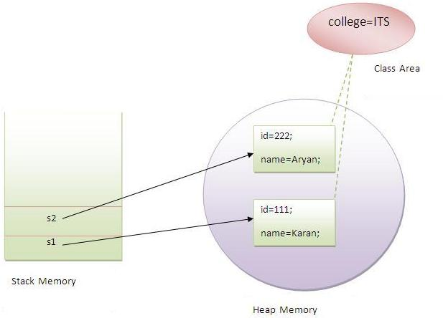
Example of static variable
//Program of static variable
class Student{
int rollno;
String name;
static String college ="ITS";
Student(int r,String n){
rollno = r;
name = n;
}
void display (){
System.out.println(rollno+" "+name+" "+college);}
public static void main(String args[]){
Student s1 = new Student (111,"Karan");
Student s2 = new Student (222,"Aryan");
s1.display();
s2.display();
}
}

Slide 143
2) static method
If you apply static keyword with any method, it is known as static method
A static method belongs to the class rather than object of a class.
A static method can be invoked without the need for creating an instance of a class.
static method can access static data member and can change the value of it.
Example of static method
//Program of changing the common property of all objects(static field).
class Student{
int rollno;
String name;
static String college = "ITS";
static void change(){
college = "BBDIT";
}
Student(int r, String n){
rollno = r;
name = n;
}
void display (){System.out.println(rollno+" "+name+" "+college);}
public static void main(String args[]){
Student.change();
Student s1 = new Student (111,"Karan");
Student s2 = new Student (222,"Aryan");
Student s3 = new Student (333,"Sonoo");
s1.display();
s2.display();
s3.display();
}
}

Slide 144
Methods declared as static have several restrictions:
  They can only call other static methods.
  They must only access static data.
  They cannot refer to this or super in any way.
  Ex:
  class A{
  int a=40;//non static
  public static void main(String args[]){
  System.out.println(a);
  }
  }

Slide 145
3)static block
Is used to initialize the static data member.
It is executed before main method at the time of class loading.
static block Syntax :
static {
statement1;
statement2;
…….
…….
}
Example of static block
class A{
static{
System.out.println("static block is invoked");
}
public static void main(String args[]){
System.out.println("Hello main");
}
}

Slide 146
4)static nested class
A static class that is created inside a class is known as static nested class. It cannot access the non-static members.
  It can access static data members of outer class including private.
  static nested class cannot access non-static (instance) data member or method.
Program of static nested class that have instance method
class Outer{
static int data=30;
static class Inner{
void msg(){System.out.println("data is "+data);}
}
public static void main(String args[]){
Outer.Inner obj=new Outer.Inner();
obj.msg();
}
}

Slide 147
// Demonstration of static variables, methods, and blocks.
public class UseStatic {
static int a = 3; //static variables
static int b;
static void meth(int x) { //static method
System.out.println("x = " + x);
System.out.println("a = " + a);
System.out.println("b = " + b);
}
static { //static block
System.out.println("Static block initialized.");
b = a * 4;
}
public static void main(String args[]) {
meth(42); //static method calling inside the class
}
}

Slide 148
String Handling
in Java a string is a sequence of characters.
But, unlike many other languages that implement strings as character arrays, Java implements strings as objects of type String.
when you create a String object, you are creating a string that cannot be changed.
That is, once a String object has been created, you cannot change the characters that comprise that string.
You can still perform all types of string operations.
The difference is that each time you need an altered version of an existing string, a new String object is created that contains the modifications.
The original string is left unchanged.
There are 3 types of String handling classes
    String
    StringBuffer
    StringTokenizer

Slide 149
String Class
The String class supports several constructors.
String is an object not an array of characters in java.
once a String object is created, you cannot change the characters that are in string.
Strings created by a StringBuffer class can be modified after they are created.
Both the String and StringBuffer classes are defined in java.lang.

Slide 150
Contd..
Constructors
    String s = new String(); - Creates an empty string.
    String s=String(char chars[ ])
    Ex:-
    char chars[ ] = { 'a', 'b', 'c' };
    String s = new String(chars);
    String(char chars[ ], int startIndex, int numChars)
    Ex:-
    char chars[] = { 'a', 'b', 'c', 'd', 'e', 'f' };
    String s = new String(chars, 2, 3);
We can also create string by using string literal.
    String s2 = "abc";

Slide 151
String(String strObj)
ex:
class s{
public static void main(String args[]) {
char c[]={‘j’,’a’, ‘v’,’a’};
String s1=new String(c);
String s2=new String(s1);
System.out.println(s1);
System.out.println(s2);
}
}

Slide 152
String(byte asciiChars[])
String(byte asciiChars[], int startIndex, Int numChars)
Ex:
class SubStringCons
{
public static void main(String args[])
{
byte ascii[]={65,66,67,68,69,70};
String s1=new String(ascii);
System.out.println(s1);
String s2=new String(ascii,2,3);
System.out.println(s2);
}
}

Slide 153
string length
the length of a string is the number of character that it contains
int length()
ex;
char chars[]={‘a’,’b’,’c’};
String s=new String(chars);
System.out.println(s.length());

Slide 154
Special String Operations
String Literals
String Concatenation
String Concatenation with Other Data Types
String Conversion and toString( )
Character Extraction
    charAt( )
    getChars( )
    getBytes( )
    toCharArray( )
String Comparison
    equals( ) and equalsIgnoreCase( )
    regionMatches( ) startsWith( ) and endsWith( )
    equals( ) Versus ==
    compareTo( )
Searching Strings
Modifying a String
    substring( )
    concat( )
    replace( )
    trim( )
Changing the Case of Characters Within a String

Slide 155
Special String Operations
String literals
char c[]={‘a’,’b’,’c’};
String s1=new String(c);
String s2=“abc”; // use string literal
System.out.println("abc".length());
String Concatenation:
String age=“9”;
String s=“he is”+age+”years old.”;
System.out.println(s);
String Concatenation with other data types
ex: String s=“four:”+2+2;
o/p: four:22
String s=“four:”+(2+2);
o/p: four: 4

Slide 156
String Conversion and toString()
syntax: String toString()
Ex:
class Box {
double width , height , depth;
Box(double w, double h, double d){
width=w;
height=h;
depth=d;
}
public String toString()
{
return "dimensions are "+width+" by" +height+" by"+depth +".";
}
}
class toStringDemo{
public static void main(String args[]){
Box b= new Box(10,12,14);
String s=" Box b:"+b; //concatenate Box objectcls
System.out.println(b); //convert Box to string
System.out.println(s);
}
}

Slide 157
Character Extraction
charAt():
to extract a single character from a string
char charAt(int where)
Ex:
char ch;
ch=“abc”.charAt(1);
getChars():
to extract more than one character at a time,
void getChars(int sourceStart,int SourceEnd,char target[],int targetStart)

Slide 158
class GetCharsDemo
{
public static void main(String args[])
{
char ch[] = new char[10];
String str = "New Version in Java";
str.getChars(5,9,ch,0);
System.out.println(ch);
}
}

Slide 159
getBytes()
byte[] getBytes()
ex:
class GetBytesDemo {
public static void main(String[] args)
{
String str = "abc“ + ”ABC”;
byte[] b = str.getBytes();
System.out.println(str);
for(int i=0;i<b.length;i++)
{
System.out.print(b[i]+" ");
}
}
}

Slide 160
toCharrArray():
-To convert all the characters in a String object into a character array
Syntax:
char[] toCharArray()

Slide 161
Ex:
public class CharArray
{
public static void main(String args[])
{
String text = "Coffee Cup";
char ch[] = text.toCharArray();
for(int i=0;i<ch.length;i++)
{
System.out.print(ch[i]);
}
}
}

Slide 162
String Comparison
To compare the strings or substrings within strings.
equals() and equalsIgnoreCase()
Syntax:
boolean equals(Object str)
-str is the String object being compared with the invoking String object
boolean equalsIgnoreCase(String str)

Slide 163
class EqualIgnoreDemo {
public static void main(String args[]) {
String str1 = “hai";
String str2 = "hai";
String str3 = “HAI“;
System.out.println("First String : "+str1);
System.out.println("Second String : "+str2);
System.out.println("Third String : "+str3);
if(str1.equals(str2))
{
System.out.println("Str1 and Str2 are Equal");
}
else
{
System.out.println("Str1 and Str2 are Not Equal");
}
if(str2.equalsIgnoreCase(str3))
{
System.out.println("Str2 and Str3 are Equal");
}
else
{
System.out.println("Str2 and Str3 are Not Equal");
} } }

Slide 164
boolean regionMatches(int startIndex, String str2,int str2StartIndex, int numChars)
boolean regionMatches(boolean ignoreCase,int startIndex, String str2, int str2StartIndex, int numChars)

Slide 165
class RegionTest
{
public static void main(String args[])
{
String str1 = "This is Test";
String str2 = "THIS IS TEST";
if(str1.regionMatches(true,5,str2,5,3)) // Case, pos1,secString,pos1,len
{
System.out.println("Strings are Equal");
}
else
{
System.out.println("Strings are NOT Equal");
}
}
}

Slide 166
String Comparison
boolean startsWith(String str) //to determine whether a given String begins with a specified string.
boolean endsWith(String str) // to determine whether the String in question ends with a specified string.
Ex: "Football".endsWith("ball") and "Football".startsWith("Foot") are both true.
boolean startsWith(String str, int startIndex) //to specifies the index into the invoking string at which point the search will begin.
Ex: "Football".startsWith("ball", 4) returns true.
equals( ) Versus ==
// It compares the characters inside a String object
//To compare two object references to see whether they refer to the same instance.

Slide 167
String Comparison
// equals() vs ==
class EqualsNotEqualTo {
public static void main(String args[]) {
String s1 = "Hello";
String s2 = new String(s1);
//String s2 = s1;
System.out.println(s1.equals(s2));
System.out.println( s1 == s2);
}
}
Output:
true
false

Slide 168
String Comparison
int compareTo(String str)
Value Meaning
Less than zero The invoking string is less than str.
Greater than zero The invoking string is greater than str.
Zero The two strings are equal.
int compareToIgnoreCase(String str)

Slide 169
String Comparison
class SortString {
static String arr[] = {
“Now", "is", "the", "time", "for", "all", "good", "men",
"to", "come", "to", "the", "aid", "of", "their", "country“};
public static void main(String args[]) {
for(int j = 0; j < arr.length; j++) {
for(int i = j + 1; i < arr.length; i++) {
if(arr[i].compareTo(arr[j]) < 0) {
String t = arr[j];
arr[j] = arr[i];
arr[i] = t;
}
}
System.out.println(arr[j]);
}
}
}
The output of this program is the list of words:
Now aid all come country for good is men of
the the their time to to

Slide 170
Searching Strings
indexOf( ) Searches for the first occurrence of a
character or substring.
lastIndexOf( ) Searches for the last occurrence of a
character or substring.

Slide 171
int indexOf(int ch)
int indexOf(String str)
int indexOf(int ch, int startIndex)
int indexOf(String str, int startIndex)
int lastIndexOf(int ch)
int lastIndexOf(String str)
int lastIndexOf(int ch, int startIndex)
int lastIndexOf(String str, int startIndex)

Slide 172
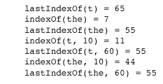
class indexOfDemo {
public static void main(String args[ ]) {
String s = "Now is the time for all good men " +
"to come to the aid of their country.";
System.out.println(s);
System.out.println("indexOf(t) = " + s.indexOf('t'));
System.out.println("lastIndexOf(t) = " + s.lastIndexOf('t'));
System.out.println("indexOf(the) = " + s.indexOf("the"));
System.out.println("lastIndexOf(the) = " + s.lastIndexOf("the"));
System.out.println("indexOf(t, 10) = " + s.indexOf('t', 10));
System.out.println("lastIndexOf(t, 60) = " + s.lastIndexOf('t', 60));
System.out.println("indexOf(the, 10) = " + s.indexOf("the", 10));
System.out.println("lastIndexOf(the, 60) = " + s.lastIndexOf("the", 60));
}
}

Slide 173
Modifying a String

Slide 174
String objects are immutable,
whenever you want to modify a String, you must either copy it into a StringBuffer or use one of the following String methods,
String substring(int startIndex)
    Here, startIndex specifies the index at which the substring will begin.
    it returns a copy of the substring that begins at startIndex and runs to the end of the invoking string.
String substring(int startIndex, int endIndex)
    Here, startIndex specifies the beginning index, and endIndex specifies the stopping point
    The string returned contains all the characters from the beginning index, up to, but not including, the ending index.

Slide 175
class SubstringDemo {
public static void main(String args[]) {
String str = "CoffeeCup";
String sub1 = str.substring(0,6);
String sub2 = str.substring(6);
System.out.println("String : "+str);
System.out.println("Sub String 1 : "+sub1);
System.out.println("Sub String 2 : "+sub2);
}
}

Slide 176
String concat(String str)
This method creates a new object that contains the invoking string with the contents of str appended to the end
EX:
String s1 = "one";
String s2 = s1.concat("two");
//Using ‘+’
String s1 = "one";
String s2 = s1 + "two";

Slide 177
Extracting Substrings
String s1 = “String’s are objects”;
s1.substring(13);
s1.substring(9, 12);
s1.substring(0, 6);
In all examples, s1 is not modified
// “objects” “are” “String”
0
1
2
3
4
5
6
7
8
9
10
11
12
13
14
15
16
17
18
19
S
t
r
i
n
g
’
s
a
r
e
o
b
j
e
c
t
s
Notes:
The string is: ‘s

Slide 178
String replace(char original, char replacement)
The replace( ) method replaces all occurrences of one character in the invoking string
with another character.
Ex:
String s = "Hello".replace('l', 'w');
String replaceAll(String original, String replacement)

Slide 179
class ReplaceDemo
{
public static void main(String[] args)
{
String str1 = "RISK";
String str2 = str1.replace('R','D');
System.out.println("First String : "+str1);
System.out.println("Second String : "+str2);
String str3 = str1.replaceAll("RI","A");
System.out.println("Third String : "+str3);
}
}

Slide 180
String trim( )
The trim( ) method returns a copy of the invoking string from which any leading and
trailing whitespace has been removed
Ex:
String s = “ Hello World ".trim();
Changing the Case of Characters Within a String
String toLowerCase( )
String toUpperCase( )

Slide 181
class LowerUpper {
public static void main(String args[]) {
String str1 = "java";
String str2 = "JAVA";
System.out.println("Upper Case Of : "+str1+" is : "+str1.toUpperCase());
System.out.println("Lower Case Of : "+str2+" is : "+str2.toLowerCase());
}
}

Slide 182
String Buffer
StringBuffer represents growable and writeable character sequences.
StringBuffer may have characters and substrings inserted in the middle or appended to the end.
StringBuffer Constructors
StringBuffer defines these three constructors:
StringBuffer( ) //reservse up to 16 char
StringBuffer(int size) //explicitly sets the size of the
StringBuffer(String str)

Slide 183
b
class BufDec
{
public static void main(String args[])
{
StringBuffer sb1 = new StringBuffer("Coffee Cup" );
StringBuffer sb2 = new StringBuffer(20);
StringBuffer sb3 = new StringBuffer();
System.out.println(sb1);
System.out.println("Buffer 1 Size : "+sb1.capacity());
System.out.println("Buffer 2 Size : "+sb2.capacity());
System.out.println("Buffer 3 Size : "+sb3.capacity());
}
}

Slide 184
int length( )
//The current length of a StringBuffer can be found via the length( ) method
int capacity( )
//The total allocated capacity can be found through the capacity( ) method.
void setLength(int len)
//To set the length of the buffer within a StringBuffer object.

Slide 185
class CapacityDemo {
public static void main(String args[]) {
StringBuffer sb1 = new StringBuffer();
System.out.println("Default Capacity : "+sb1.capacity());
System.out.println("Default Length : "+sb1.length());
sb1.setLength(10);
System.out.println("Length : "+sb1.length());
}
}

Slide 186
char charAt(int where)
//The value of a single character can be obtained from a StringBuffer via the charAt( ) method.
void setCharAt(int where, char ch)
//To set the value of a character, ch specifies the new value of that character
EX:// Demonstrate charAt() and setCharAt()
class setCharAtDemo {
public static void main(String args[]) {
StringBuffer sb = new StringBuffer("Hello");
System.out.println("buffer before = " + sb);
System.out.println("charAt(1) before = " + sb.charAt(1));
sb.setCharAt(1, 'i');
sb.setLength(2);
System.out.println("buffer after = " + sb);
System.out.println("charAt(1) after = " + sb.charAt(1));
} }
Void getChars(int sourceStart,int sourceEnd,char target[],int targetStart)
// To copy a substring of a StringBuffer into an array

Slide 187
append():
// concatenates the string representation of any other type of data to the end of the invoking StringBuffer object
StringBuffer append(String str)
StringBuffer append(int num)
StringBuffer append(Object obj)
String.valueOf( ) is called for each parameter to obtain its string representation. The result is appended to the current StringBuffer object.

Slide 188
class appendDemo{
public static void main(String args[]){
String s;
int a=30;
StringBuffer sb= new StringBuffer(40);
s=sb.append(“a=“).append(a).append(“!”).toString();
}
}

Slide 189
insert( )
The insert( ) method inserts one string into another.
StringBuffer insert(int index, String str)
StringBuffer insert(int index, char ch)
StringBuffer insert(int index, Object obj)

Slide 190
class InsertDemo {
public static void main(String args[]) {
char ch[] = {'J','A','V','A'};
StringBuffer sb1 = new StringBuffer("ring");
System.out.println("String is : "+sb1);
StringBuffer sb2 = sb1.insert(0,'B');
System.out.println("String after inserting 'B' : "+sb2);
StringBuffer sb3 = sb1.insert(sb1.length(),ch);
System.out.println("String after inserting chars (java) : "+sb3);
}
}

Slide 191
StringBuffer reverse()
// reverse the characters within a StringBuffer object using reverse( )
// Using reverse() to reverse a StringBuffer.
Ex: class ReverseDemo{
public static void main(String args[]){
StringBuffer s= new StringBuffer(“abcdef”);
System.out.println(s);
s.reverse();
System.out.println(s);
}
}

Slide 192
delete() and deleteCharAt()
deletes a sequence of characters from the invoking object.
StringBuffer delete(int startIndex, int endIndex)
StringBuffer deleteCharAt(int loc)
class deleteDemo{
public static void main(String args[]){
StringBuffer sb = new StringBuffer(“this is test.”);
sb.delete(4,7);
System.out.println(“After delete: “+sb);
sb.deleteCharAt(0);
System.out.println(“After deleteCharAt: “+sb);
}
}

Slide 193
StringBuffer replace(int startIndex, int endIndex, String str)
Ex:
StringBuffer sb= new StringBuffer(“this is a test”);
Sb.replace(5,7,”was”);
String substring(int startIndex)
//to return sub strings.
String substring(int startIndex, int endIndex)

Slide 194
StringTokenizer
The StringTokenizer class provides the first step in this parsing process, often called the lexer (lexical analyzer) or scanner
Parsing is the division of text into a set of discrete parts, or tokens
To use StringTokenizer
you specify an input string and a string that contains delimiters
Delimiters are characters that separate tokens
Each character in the delimiters string is considered a valid delimiter
ex: “ ,;:”
The default set of delimiters consists of the whitespace characters:,space, tab, newline,carriage return
token <= identifier | keyword | separator | operator | literal | comment

Slide 195
The StringTokenizer constructors
StringTokenizer(String str)
StringTokenizer(String str, String delimiters)
StringTokenizer(String str, String delimiters, boolean delimAsToken)
in all versions, str is the string that will be tokenized.

Slide 196
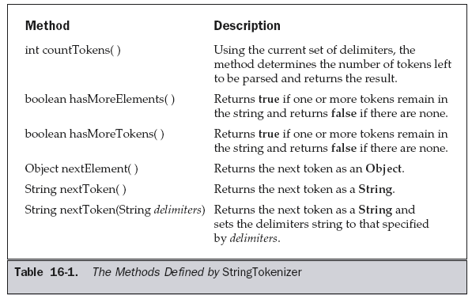

Slide 197
import java.util.*;
class StringToken{
public static void main(String args[]){
String s=“hello=java,test”;
/*Scanner input=new Scanner(System.in);
String s=input.next();*/
StringTokenizer st=new StringTokenizer(s);
//StringTokenizer st=new StringTokenizer(s,“=,");
//StringTokenizer st=new StringTokenizer(s,"=,",true);
while(st.hasMoreTokens()) {
String result=st.nextToken();
System.out.println(result);
}
}
}

Slide 198
Write a java program that reads a line of integers and then displays each integer and find the sum of the integers (using StringTokenizer)

Slide 199
import java.util.*;
class SumOfInt{
public static void main(String args[]){
//String s=“1+2+3+4+5+6+7”;
Scanner s= new Scanner(System.in);
String t=s.next();
int sum=0;
StringTokenizer st=new StringTokenizer(t,"+");
while(st.hasMoreTokens())
{
String a=st.nextToken();
System.out.println(a);
sum=sum+Integer.parseInt(a);
}
System.out.println("sum of all integers is: "+sum);
}
}

Slide 200
token <= identifier | keyword | separator | operator | literal | comment
Identifiers: names the programmer chooses
Keywords: names already in the programming language
Separators (also known as punctuators): punctuation characters and
paired-delimiters
Operators: symbols that operate on arguments and produce results
Literals (specified by their type)
  Numeric: int and double
  Logical: boolean
  Textual: char and String
  Reference: null
Comments
  Line
  Block

